Slide 1
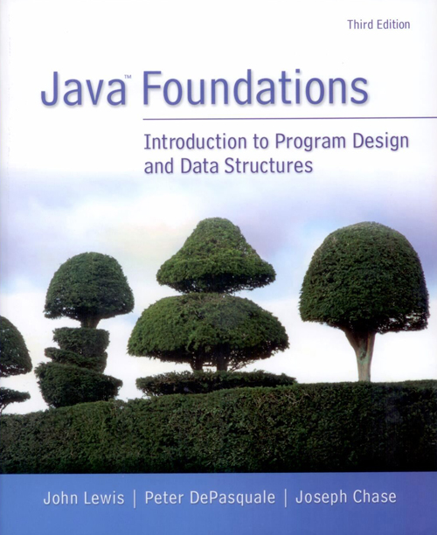
Chapter 7
Arrays

Slide 2
Chapter Scope
Array declaration and use
Bounds checking
Arrays as objects
Arrays of objects
Command-line arguments
Variable-length parameter lists
Multidimensional arrays

Slide 3
Arrays
An array is an ordered list of values
The entire array
has a single name
Each value has a numeric index
0 1 2 3 4 5 6 7 8 9
scores
79 87 94 82 67 98 87 81 74 91
An array of size N is indexed from zero to N-1
This array holds 10 values that are indexed from 0 to 9

Slide 4
Arrays
A particular value in an array is referenced using the array name followed by the index in brackets
For example, the expression
scores[2]
refers to the value 94 (the 3rd value in the array)
That expression represents a place to store a single integer and can be used wherever an integer variable can be used

Slide 5
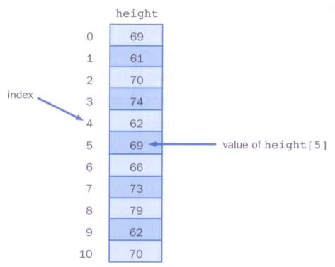
Arrays
Arrays can be depicted vertically or horizontally

Slide 6
Arrays
An array element can be assigned a value, printed, or used in a calculation
scores[2] = 89;
scores[first] = scores[first] + 2;
mean = (scores[0] + scores[1])/2;
System.out.println("Top = " + scores[5]);

Slide 7
Arrays
The values held in an array are called array elements
An array stores multiple values of the same type – the element type
The element type can be a primitive type or an object reference
Therefore, we can create an array of integers, an array of characters, an array of String objects, an array of Coin objects, etc.
In Java, the array itself is an object that must be instantiated

Slide 8
Declaring Arrays
The scores array could be declared as follows
int[] scores = new int[10];
The type of the variable scores is int[] (an array of integers)
Note that the array type does not specify its size, but each object of that type has a specific size
The reference variable scores is set to a new array object that can hold 10 integers

Slide 9
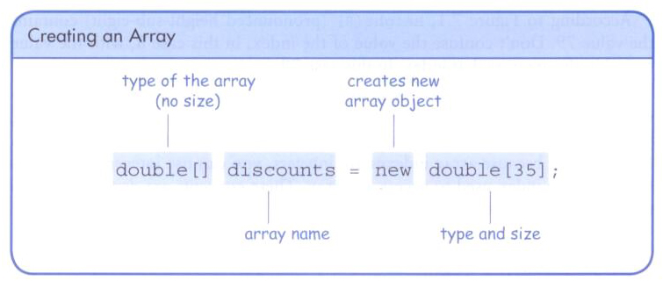
Declaring Arrays

Slide 10
Declaring Arrays
Some other examples of array declarations
float[] prices = new float[500];
boolean[] flags;
flags = new boolean[20];
char[] codes = new char[1750];

Slide 11
Using Arrays
The for-each loop can be used when processing array elements:
for (int score : scores)
System.out.println(score);
This is only appropriate when processing all array elements from the lowest index to the highest index

Slide 12
//********************************************************************
// BasicArray.java Java Foundations
//
// Demonstrates basic array declaration and use.
//********************************************************************
public class BasicArray
{
//-----------------------------------------------------------------
// Creates an array, fills it with various integer values,
// modifies one value, then prints them out.
//-----------------------------------------------------------------
public static void main(String[] args)
{
final int LIMIT = 15, MULTIPLE = 10;
int[] list = new int[LIMIT];
// Initialize the array values
for (int index = 0; index < LIMIT; index++)
list[index] = index * MULTIPLE;
list[5] = 999; // change one array value
// Print the array values
for (int value : list)
System.out.print(value + " ");
}
}

Slide 13
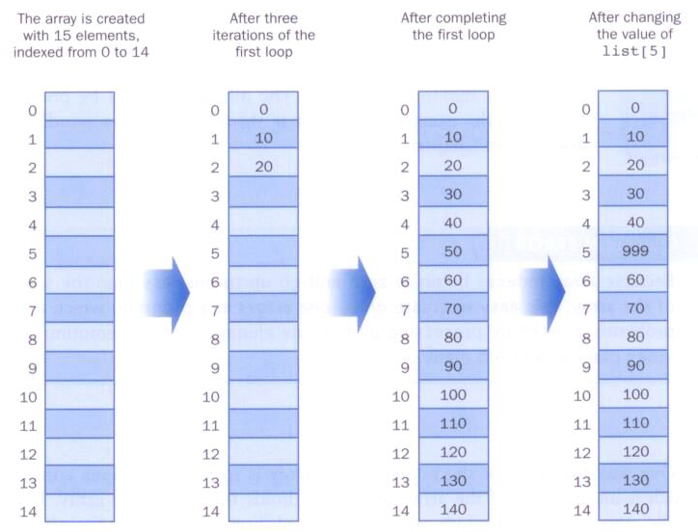
BasicArray Example

Slide 14
Bounds Checking
Once an array is created, it has a fixed size
An index used in an array reference must specify a valid element
That is, the index value must be in range 0 to N-1
The Java interpreter throws an ArrayIndexOutOfBoundsException if an array index is out of bounds
This is called automatic bounds checking

Slide 15
Bounds Checking
For example, if the array codes can hold 100 values, it can be indexed using only the numbers 0 to 99
If the value of count is 100, then the following reference will cause an exception to be thrown
System.out.println(codes[count]);
It’s common to introduce off-by-one errors when using arrays
problem
for (int index=0; index <= 100; index++)
codes[index] = index*50 + epsilon;

Slide 16
Bounds Checking
Each array object has a public constant called length that stores the size of the array
It is referenced using the array name
scores.length
Note that length holds the number of elements, not the largest index

Slide 17
//********************************************************************
// ReverseOrder.java Java Foundations
//
// Demonstrates array index processing.
//********************************************************************
import java.util.Scanner;
public class ReverseOrder
{
//-----------------------------------------------------------------
// Reads a list of numbers from the user, storing them in an
// array, then prints them in the opposite order.
//-----------------------------------------------------------------
public static void main(String[] args)
{
Scanner scan = new Scanner(System.in);
double[] numbers = new double[10];
System.out.println("The size of the array: " + numbers.length);
for (int index = 0; index < numbers.length; index++)
{
System.out.print("Enter number " + (index+1) + ": ");
numbers[index] = scan.nextDouble();
}

Slide 18
System.out.println("The numbers in reverse order:");
for (int index = numbers.length-1; index >= 0; index--)
System.out.print(numbers[index] + " ");
}
}

Slide 19
//********************************************************************
// LetterCount.java Java Foundations
//
// Demonstrates the relationship between arrays and strings.
//********************************************************************
import java.util.Scanner;
public class LetterCount
{
//-----------------------------------------------------------------
// Reads a sentence from the user and counts the number of
// uppercase and lowercase letters contained in it.
//-----------------------------------------------------------------
public static void main(String[] args)
{
final int NUMCHARS = 26;
Scanner scan = new Scanner(System.in);
int[] upper = new int[NUMCHARS];
int[] lower = new int[NUMCHARS];
char current; // the current character being processed
int other = 0; // counter for non-alphabetics
System.out.println("Enter a sentence:");
String line = scan.nextLine();

Slide 20
// Count the number of each letter occurrence
for (int ch = 0; ch < line.length(); ch++)
{
current = line.charAt(ch);
if (current >= 'A' && current <= 'Z')
upper[current-'A']++;
else
if (current >= 'a' && current <= 'z')
lower[current-'a']++;
else
other++;
}
// Print the results
System.out.println ();
for (int letter=0; letter < upper.length; letter++)
{
System.out.print((char) (letter + 'A'));
System.out.print(": " + upper[letter]);
System.out.print("\t\t" + (char) (letter + 'a'));
System.out.println(": " + lower[letter]);
}
System.out.println();
System.out.println("Non-alphabetic characters: " + other);
}
}

Slide 21
Alternate Array Syntax
The brackets of the array type can be associated with the element type or with the name of the array
Therefore the following two declarations are equivalent
float[] prices;
float prices[];
The first format generally is more readable and should be used

Slide 22
Initializer Lists
An initializer list can be used to instantiate and fill an array in one step
The values are delimited by braces and separated by commas
Examples:
int[] units = {147, 323, 89, 933, 540,
269, 97, 114, 298, 476};
char[] letterGrades = {'A', 'B', 'C', 'D', ’F'};

Slide 23
Initializer Lists
Note that when an initializer list is used
the new operator is not used
no size value is specified
The size of the array is determined by the number of items in the initializer list
An initializer list can be used only in the array declaration

Slide 24
//********************************************************************
// Primes.java Java Foundations
//
// Demonstrates the use of an initializer list for an array.
//********************************************************************
public class Primes
{
//-----------------------------------------------------------------
// Stores some prime numbers in an array and prints them.
//-----------------------------------------------------------------
public static void main(String[] args)
{
int[] primeNums = {2, 3, 5, 7, 11, 13, 17, 19};
System.out.println("Array length: " + primeNums.length);
System.out.println("The first few prime numbers are:");
for (int prime : primeNums)
System.out.print(prime + " ");
}
}

Slide 25
Arrays as Parameters
An entire array can be passed as a parameter to a method
Like any other object, the reference to the array is passed, making the formal and actual parameters aliases of each other
Therefore, changing an array element within the method changes the original
An individual array element can be passed to a method as well, in which case the type of the formal parameter is the same as the element type

Slide 26
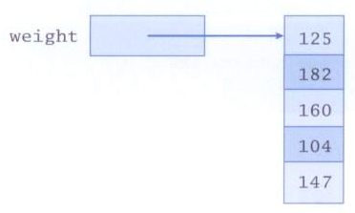
Arrays of Objects
An array is an object and an array can hold objects as elements
The array name is an object reference variable
So this is another way to depict an array:

Slide 27
Arrays of Objects
An array of objects really holds object references
The following declaration reserves space to store 5 references to String objects
String[] words = new String[5];
It does not create the String objects themselves
Initially an array of objects holds null references
Each object stored in an array must be instantiated separately

Slide 28
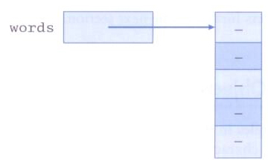
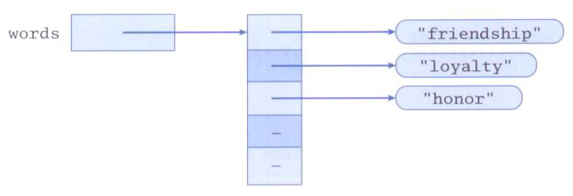
Arrays of Objects
After initial creation, an array holds null references:
Each element is a reference to an object:

Slide 29
Arrays of Objects
Keep in mind that String objects can be created using literals
The following declaration creates an array object called verbs and fills it with four String objects created using string literals
String[] verbs = {"play", "work", "eat", "sleep"};
The following example creates an array of Grade objects, each with a string representation and a numeric lower bound

Slide 30
//********************************************************************
// GradeRange.java Java Foundations
//
// Demonstrates the use of an array of objects.
//********************************************************************
public class GradeRange
{
//-----------------------------------------------------------------
// Creates an array of Grade objects and prints them.
//-----------------------------------------------------------------
public static void main(String[] args)
{
Grade[] grades =
{
new Grade("A", 95), new Grade("A-", 90),
new Grade("B+", 87), new Grade("B", 85), new Grade("B-", 80),
new Grade("C+", 77), new Grade("C", 75), new Grade("C-", 70),
new Grade("D+", 67), new Grade("D", 65), new Grade("D-", 60),
new Grade("F", 0)
};
for (Grade letterGrade : grades)
System.out.println(letterGrade);
}
}

Slide 31
//********************************************************************
// Grade.java Java Foundations
//
// Represents a school grade.
//********************************************************************
public class Grade
{
private String name;
private int lowerBound;
//-----------------------------------------------------------------
// Constructor: Sets up this Grade object with the specified
// grade name and numeric lower bound.
//-----------------------------------------------------------------
public Grade(String grade, int cutoff)
{
name = grade;
lowerBound = cutoff;
}
//-----------------------------------------------------------------
// Returns a string representation of this grade.
//-----------------------------------------------------------------
public String toString()
{
return name + "\t" + lowerBound;
}

Slide 32
//-----------------------------------------------------------------
// Name mutator.
//-----------------------------------------------------------------
public void setName(String grade)
{
name = grade;
}
//-----------------------------------------------------------------
// Lower bound mutator.
//-----------------------------------------------------------------
public void setLowerBound(int cutoff)
{
lowerBound = cutoff;
}
//-----------------------------------------------------------------
// Name accessor.
//-----------------------------------------------------------------
public String getName()
{
return name;
}
//-----------------------------------------------------------------
// Lower bound accessor.
//-----------------------------------------------------------------
public int getLowerBound()
{
return lowerBound;
}
}

Slide 33
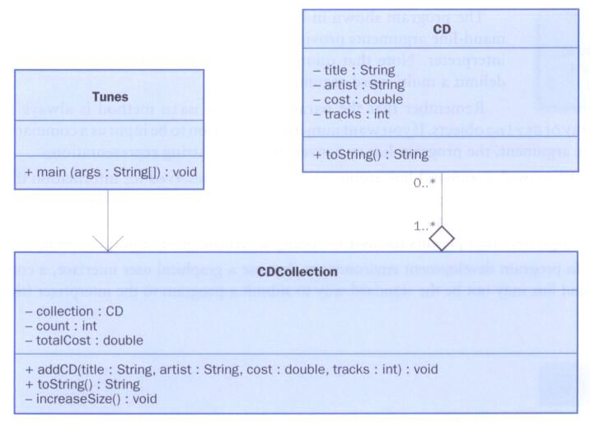
Arrays of Objects
Now let's look at an example that stores a collection of CD objects

Slide 34
//********************************************************************
// Tunes.java Java Foundations
//
// Demonstrates the use of an array of objects.
//********************************************************************
public class Tunes
{
//-----------------------------------------------------------------
// Creates a CDCollection object and adds some CDs to it. Prints
// reports on the status of the collection.
//-----------------------------------------------------------------
public static void main (String[] args)
{
CDCollection music = new CDCollection ();
music.addCD("Storm Front", "Billy Joel", 14.95, 10);
music.addCD("Come On Over", "Shania Twain", 14.95, 16);
music.addCD("Soundtrack", "Les Miserables", 17.95, 33);
music.addCD("Graceland", "Paul Simon", 13.90, 11);
System.out.println(music);
music.addCD("Double Live", "Garth Brooks", 19.99, 26);
music.addCD("Greatest Hits", "Jimmy Buffet", 15.95, 13);
System.out.println(music);
}
}

Slide 35
//********************************************************************
// CDCollection.java Java Foundations
//
// Represents a collection of compact discs.
//********************************************************************
import java.text.NumberFormat;
public class CDCollection
{
private CD[] collection;
private int count;
private double totalCost;
//-----------------------------------------------------------------
// Constructor: Creates an initially empty collection.
//-----------------------------------------------------------------
public CDCollection()
{
collection = new CD[100];
count = 0;
totalCost = 0.0;
}

Slide 36
//-----------------------------------------------------------------
// Adds a CD to the collection, increasing the size of the
// collection if necessary.
//-----------------------------------------------------------------
public void addCD(String title, String artist, double cost,
int tracks)
{
if (count == collection.length)
increaseSize();
collection[count] = new CD(title, artist, cost, tracks);
totalCost += cost;
count++;
}

Slide 37
//-----------------------------------------------------------------
// Returns a report describing the CD collection.
//-----------------------------------------------------------------
public String toString()
{
NumberFormat fmt = NumberFormat.getCurrencyInstance();
String report = "~~~~~~~~~~~~~~~~~~~~~~~~~~~~~~~~~~~~~~~~~~~\n";
report += "My CD Collection\n\n";
report += "Number of CDs: " + count + "\n";
report += "Total cost: " + fmt.format(totalCost) + "\n";
report += "Average cost: " + fmt.format(totalCost/count);
report += "\n\nCD List:\n\n";
for (int cd = 0; cd < count; cd++)
report += collection[cd].toString() + "\n";
return report;
}

Slide 38
//-----------------------------------------------------------------
// Increases the capacity of the collection by creating a
// larger array and copying the existing collection into it.
//-----------------------------------------------------------------
private void increaseSize()
{
CD[] temp = new CD[collection.length * 2];
for (int cd = 0; cd < collection.length; cd++)
temp[cd] = collection[cd];
collection = temp;
}
}

Slide 39
//********************************************************************
// CD.java Java Foundations
//
// Represents a compact disc.
//********************************************************************
import java.text.NumberFormat;
public class CD
{
private String title, artist;
private double cost;
private int tracks;
//-----------------------------------------------------------------
// Creates a new CD with the specified information.
//-----------------------------------------------------------------
public CD(String name, String singer, double price, int numTracks)
{
title = name;
artist = singer;
cost = price;
tracks = numTracks;
}

Slide 40
//-----------------------------------------------------------------
// Returns a string description of this CD.
//-----------------------------------------------------------------
public String toString()
{
NumberFormat fmt = NumberFormat.getCurrencyInstance();
String description;
description = fmt.format(cost) + "\t" + tracks + "\t";
description += title + "\t" + artist;
return description;
}
}

Slide 41
Command-Line Arguments
The signature of the main method indicates that it takes an array of String objects as a parameter
These values come from command-line arguments that are provided when the interpreter is invoked
For example, the following invocation of the interpreter passes three String objects into main
> java StateEval pennsylvania texas arizona
These strings are stored at indexes 0-2 of the array parameter of the main method

Slide 42
//********************************************************************
// CommandLine.java Java Foundations
//
// Demonstrates the use of command line arguments.
//********************************************************************
public class CommandLine
{
//-----------------------------------------------------------------
// Prints all of the command line arguments provided by the
// user.
//-----------------------------------------------------------------
public static void main(String[] args)
{
for (String arg : args)
System.out.println(arg);
}
}

Slide 43
Variable Length Parameter Lists
Suppose we wanted to create a method that processed a different amount of data from one invocation to the next
For example, let's define a method called average that returns the average of a set of integer parameters
// one call to average three values
mean1 = average (42, 69, 37);
// another call to average seven values
mean2 = average (35, 43, 93, 23, 40, 21, 75);

Slide 44
Variable Length Parameter Lists
We could define overloaded versions of the average method
Downside: we'd need a separate version of the method for each parameter count
We could define the method to accept an array of integers
Downside: we'd have to create the array and store the integers prior to calling the method each time
Instead, Java provides a convenient way to create variable length parameter lists

Slide 45
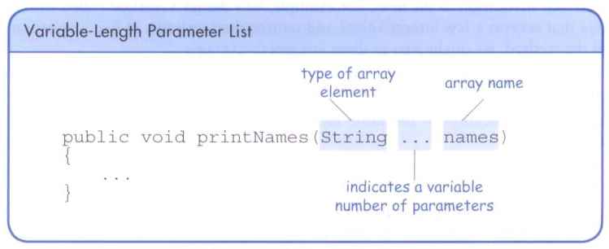
Variable Length Parameter Lists
Using special syntax in the formal parameter list, we can define a method to accept any number of parameters of the same type
For each call, the parameters are automatically put into an array for easy processing in the method

Slide 46
Variable Length Parameter Lists
public double average(int ... list)
{
double result = 0.0;
if (list.length != 0)
{
int sum = 0;
for (int num : list)
sum += num;
result = (double)num / list.length;
}
return result;
}

Slide 47
Variable Length Parameter Lists
The type of the parameter can be any primitive or object type
public void printGrades(Grade ... grades)
{
for (Grade letterGrade : grades)
System.out.println (letterGrade);
}

Slide 48
Variable Length Parameter Lists
A method that accepts a variable number of parameters can also accept other parameters
The following method accepts an int, a String object, and a variable number of double values into an array called nums
public void test(int count, String name,
double ... nums)
{
// whatever
}

Slide 49
Variable Length Parameter Lists
The varying number of parameters must come last in the formal arguments
A single method cannot accept two sets of varying parameters
Constructors can also be set up to accept a variable number of parameters

Slide 50
//********************************************************************
// VariableParameters.java Java Foundations
//
// Demonstrates the use of a variable length parameter list.
//********************************************************************
public class VariableParameters
{
//-----------------------------------------------------------------
// Creates two Family objects using a constructor that accepts
// a variable number of String objects as parameters.
//-----------------------------------------------------------------
public static void main(String[] args)
{
Family lewis = new Family("John", "Sharon", "Justin", "Kayla",
"Nathan", "Samantha");
Family camden = new Family("Stephen", "Annie", "Matt", "Mary",
"Simon", "Lucy", "Ruthie", "Sam", "David");
System.out.println(lewis);
System.out.println();
System.out.println(camden);
}
}

Slide 51
//********************************************************************
// Family.java Java Foundations
//
// Demonstrates the use of variable length parameter lists.
//********************************************************************
public class Family
{
private String[] members;
//-----------------------------------------------------------------
// Constructor: Sets up this family by storing the (possibly
// multiple) names that are passed in as parameters.
//-----------------------------------------------------------------
public Family(String ... names)
{
members = names;
}
//-----------------------------------------------------------------
// Returns a string representation of this family.
//-----------------------------------------------------------------
public String toString()
{
String result = "";
for (String name : members)
result += name + "\n";
return result;
}
}

Slide 52
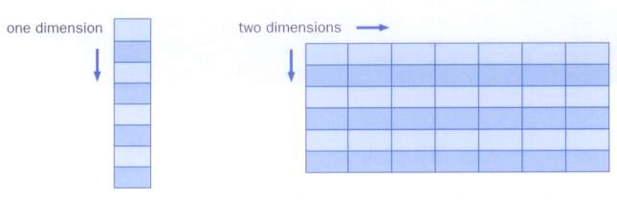
Two-Dimensional Arrays
A one-dimensional array stores a list of elements
A two-dimensional array can be thought of as a table of elements, with rows and columns

Slide 53
Two-Dimensional Arrays
To be precise, in Java a two-dimensional array is an array of arrays
A two-dimensional array is declared by specifying the size of each dimension separately
int[][] scores = new int[12][50];
A array element is referenced using two index values
value = scores[3][6]
The array stored in one row can be specified using one index

Slide 54
//********************************************************************
// TwoDArray.java Java Foundations
//
// Demonstrates the use of a two-dimensional array.
//********************************************************************
public class TwoDArray
{
//-----------------------------------------------------------------
// Creates a 2D array of integers, fills it with increasing
// integer values, then prints them out.
//-----------------------------------------------------------------
public static void main(String[] args)
{
int[][] table = new int[5][10];
// Load the table with values
for (int row=0; row < table.length; row++)
for (int col=0; col < table[row].length; col++)
table[row][col] = row * 10 + col;
// Print the table
for (int row=0; row < table.length; row++)
{
for (int col=0; col < table[row].length; col++)
System.out.print(table[row][col] + "\t");
System.out.println();
}
}
}

Slide 55
Two-Dimensional Arrays
Expression | Type | Description
table | int[][] | 2D array of integers, or array of integer arrays
table[5] | int[] | array of integers
table[5][12] | int | integer

Slide 56
//********************************************************************
// SodaSurvey.java Java Foundations
//
// Demonstrates the use of a two-dimensional array.
//********************************************************************
import java.text.DecimalFormat;
public class SodaSurvey
{
//-----------------------------------------------------------------
// Determines and prints the average of each row (soda) and each
// column (respondent) of the survey scores.
//-----------------------------------------------------------------
public static void main (String[] args)
{
int[][] scores = { {3, 4, 5, 2, 1, 4, 3, 2, 4, 4},
{2, 4, 3, 4, 3, 3, 2, 1, 2, 2},
{3, 5, 4, 5, 5, 3, 2, 5, 5, 5},
{1, 1, 1, 3, 1, 2, 1, 3, 2, 4} };
final int SODAS = scores.length;
final int PEOPLE = scores[0].length;
int[] sodaSum = new int[SODAS];
int[] personSum = new int[PEOPLE];

Slide 57
for (int soda=0; soda < SODAS; soda++)
for (int person=0; person < PEOPLE; person++)
{
sodaSum[soda] += scores[soda][person];
personSum[person] += scores[soda][person];
}
DecimalFormat fmt = new DecimalFormat("0.#");
System.out.println("Averages:\n");
for (int soda=0; soda < SODAS; soda++)
System.out.println("Soda #" + (soda+1) + ": " +
fmt.format((float)sodaSum[soda]/PEOPLE));
System.out.println ();
for (int person=0; person < PEOPLE; person++)
System.out.println("Person #" + (person+1) + ": " +
fmt.format((float)personSum[person]/SODAS));
}
}

Slide 58
Multidimensional Arrays
Any array with more than one dimension is a multidimensional array
Each dimension subdivides the previous one into the specified number of elements
Each dimension has its own length constant
Because each dimension is an array of array references, the arrays within one dimension can be of different lengths
these are sometimes called ragged arrays

Slide 59
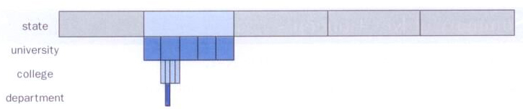
Multidimensional Arrays
One way to visualize a four-dimensional array:
Two-dimensional arrays are common, but beyond that usually an array has other objects involved

